Slide 1
.NET Aspire with JavaScript
Chris Noring

Slide 2
.NET Aspire Developers Day
Start your learning journey:
aka.ms/dotnetAspireDevDay/Collection

Slide 3
Agenda
01
02
03
What is .NET Aspire
Your first .NET Aspire project
Orchestration explained
04
05
06
.NET Aspire + Frontend JavaScript
.NET Aspire + Node.js
CTAs

Slide 4
Chapter 1: .NET ASPIRE

Slide 5
Your problems building cloud apps
Not easy to build distributed apps. It's not easy to build a distributed applications with many components, configurations and more, what about local dev?
Specific problems in prod. Resilience, telemetry, health, service discovery and more
Reinventing the wheel, you keep writing the same code to use the usual suspects, DBs, cache, auth, queues etc

Slide 6
Local dev
version: '3.8'
services:
frontend:
image: node:18-alpine
working_dir: /app
volumes:
- ./frontend:/app
ports:
- "3000:3000"
command: npm start
backend:
image: node:18-alpine
working_dir: /app
volumes:
- ./backend:/app
ports:
- "5000:5000"
command: npm run dev
depends_on:
- db
- cache
db:​
image: mysql:8.0​
environment:​
MYSQL_ROOT_PASSWORD: example​
MYSQL_DATABASE: exampledb​
ports:​
- "3306:3306"​
volumes:​
- db_data:/var/lib/mysql​
​
cache:​
image: redis:alpine​
ports:​
- "6379:6379"​
​
volumes:​
db_data:​
​
Running containers, e.g Docker Compose
Many components need to talk to each other to emulate what it's like in prod
Spend time on config. Spend your time writing yml for your setup:
Do I need to be a Container Ninja or can I use code?

Slide 7


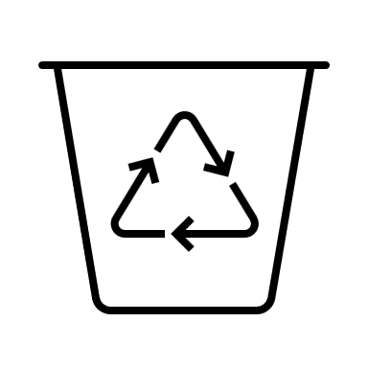

.NET Aspire is here to save you
Improve experience of building Cloud Native Apps
Orchestration
Reusable Components
1st class Tooling
Notes:
Improve the experience of building Cloud native .NET Apps.
.NET Aspire is designed to improve the experience of building .NET cloud-native apps. It provides a consistent, opinionated set of tools and patterns that help you build and run distributed apps. .NET Aspire is designed to help you with:
Orchestration: .NET Aspire provides features for running and connecting multi-project applications and their dependencies for local development environments.
Components: .NET Aspire components are NuGet packages for commonly used services, such as Redis or Postgres, with standardized interfaces ensuring they connect consistently and seamlessly with your app.
Tooling: .NET Aspire comes with project templates and tooling experiences for Visual Studio, Visual Studio Code, and the dotnet CLI to help you create and interact with .NET Aspire projects.

Slide 8



Key features and components
Service discovery
Telemetry
Resilience
Health checks
Notes:
Service Discovery: .NET Aspire helps applications discover and communicate with other services in a dynamic environment.
Telemetry: It offers built-in telemetry capabilities, allowing you to monitor and analyze your application’s behavior.
Resilience: .NET Aspire includes patterns for handling transient failures, retries, and circuit breakers.
Health Checks: Applications built with .NET Aspire can expose health endpoints to verify their operational status.

Slide 9

Use cases
When to use .NET Aspire
Observable, production-ready, distributed applications with .NET, .NET Aspire can be a valuable tool in your toolkit.
Cloud native apps that scales. It’s particularly useful for cloud-native scenarios where applications need to scale dynamically, handle failures gracefully, and communicate with other services.
Notes:
Use Cases:
If you’re building observable, production-ready, distributed applications with .NET, .NET Aspire can be a valuable tool in your toolkit.
It’s particularly useful for cloud-native scenarios where applications need to scale dynamically, handle failures gracefully, and communicate with other services.

Slide 10

Orchestration
What speaks to what and how
Focuses on enhancing the local development experience by simplifying the management of your cloud-native app's configuration and interconnections
Provides a set of abstractions that streamline the setup of service discovery, environment variables, and container configurations, eliminating the need to deal with low-level implementation details
Ensure a consistent setup pattern across apps with numerous components and services, making it easier to manage complex applications during the development phase
Notes:
Focuses on enhancing the local development experience by simplifying the management of your cloud-native app's configuration and interconnections
Provides a set of abstractions that streamline the setup of service discovery, environment variables, and container configurations, eliminating the need to deal with low-level implementation details
Ensure a consistent setup pattern across apps with numerous components and services, making it easier to manage complex applications during the development phase

Slide 11
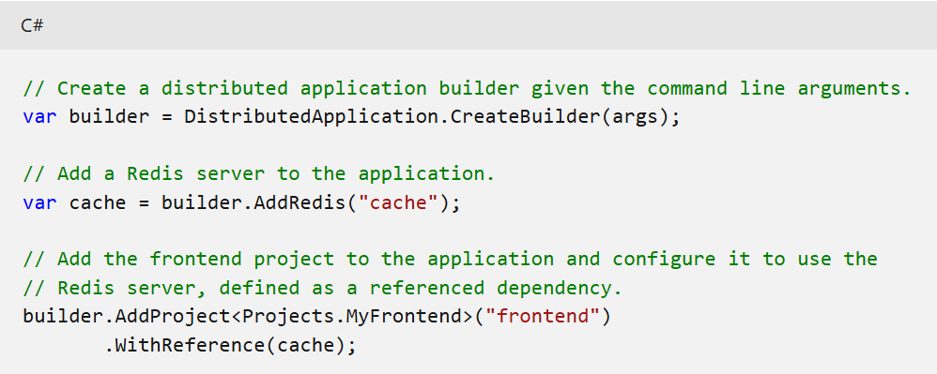
Orchestration cont.
.NET Aspire assists with the following concerns
App composition: Specify the .NET projects, containers, executables, and cloud resources that make up the application.
Service discovery and connection string management: The app host manages injecting the right connection strings or network configurations and service discovery information to simplify the developer experience.
Example, using .NET Aspire, the following code creates a local Redis container resource and configures the appropriate connection string in the "frontend" project with only two helper method calls:

Slide 12
Project templates and tooling
Standardized. .NET Aspire projects follow a standardized structure designed around the default .NET Aspire project templates.
Three core projects. Most .NET Aspire projects have at least three projects:
Starter app,
could be any common .NET project such as a Blazor UI or Minimal API.
App Host,
manage the high level orchestration concerns of the app
Service Defaults
contains default .NET Aspire project configurations that can be extended and customized as needed
Notes:
.NET Aspire projects follow a standardized structure designed around the default .NET Aspire project templates. Most .NET Aspire projects have at least three projects:
MyFirstAspireApp: Your starter app, which could be any common .NET project such as a Blazor UI or Minimal API. You can add more projects to your app as it expands and manage orchestration between them using the .AppHost and .ServiceDefaults project.
MyFirstAspireApp.AppHost: The .AppHost project is used to manage the high level orchestration concerns of the app. Orchestration involves putting together various parts of your app, like APIs, service containers, and executables, and setting up how they find and communicate with each other.
MyFirstAspireApp.ServiceDefaults: The .ServiceDefaults project contains default .NET Aspire project configurations that can be extended and customized as needed. These configurations include concerns such as setting up health checks, OpenTelemetry settings, and more.

Slide 13
Chapter 2: Getting started with .NET Aspire

Slide 14
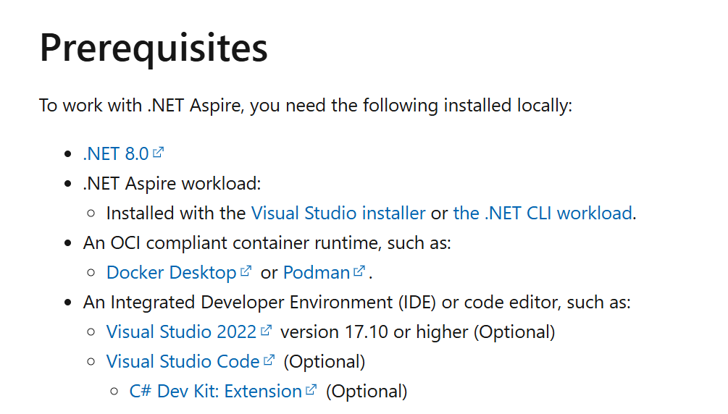
What do I need to get started?
Install the below
.NET 8.0
.NET Aspire workload
OCI Compliant runtime e.g Docker Desktop or Podman
IDE, e.g VS, VS Code,
IDE extension
https://aka.ms/aspire-get-started
Notes:
Cloud-native apps often require connections to various services such as databases, storage and caching solutions, messaging providers, or other web services.
.NET Aspire is designed to streamline connections and configurations between these types of services

Slide 15
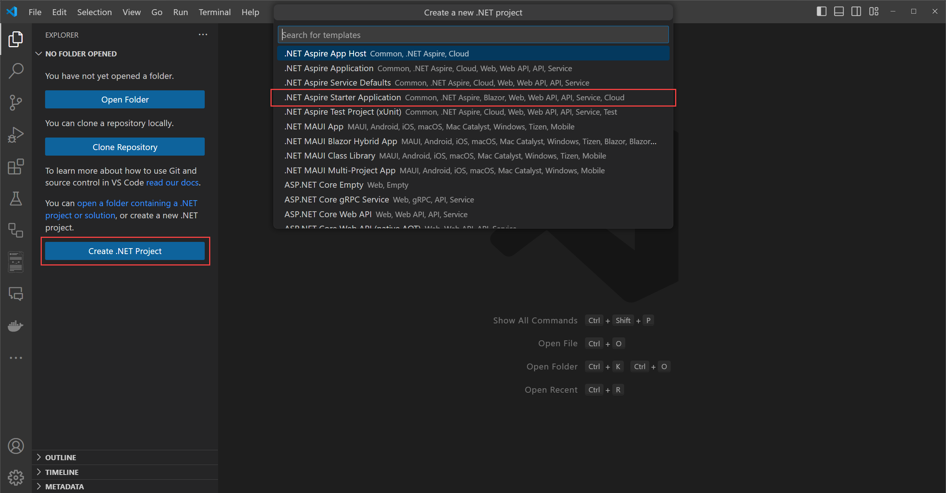
Scaffold your project
Use command palette
Many different choices, including “starter”
Also via terminal

Slide 16
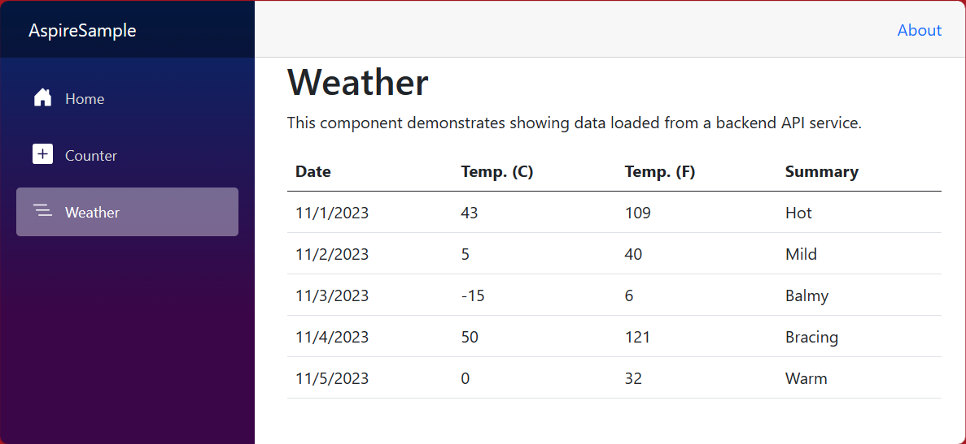
What you get in a starter template
What's in them
Install extension for Visual Studio or Visual Studio Code depending on your choice of IDE
NET Aspire Application:
Includes projects
AspireSample.AppHost
orchestrator
AspireSample.ServiceDefaults
Capabilities e.g. telemetry, health checks etc.
API (.NET)
Frontend (ASP .NET)
https://aka.ms/aspire-get-started
Notes:
NET Aspire Application: A basic starter template that only includes the AspireSample.AppHost and AspireSample.ServiceDefaults projects. This template is designed to only provide the essentials for you to build off of.
.NET Aspire Starter Application: This template includes the AspireSample.AppHost and AspireSample.ServiceDefaults projects, but also includes boilerplate UI and API projects. These projects are pre-configured with service discovery and other basic examples of common .NET Aspire functionality.

Slide 17
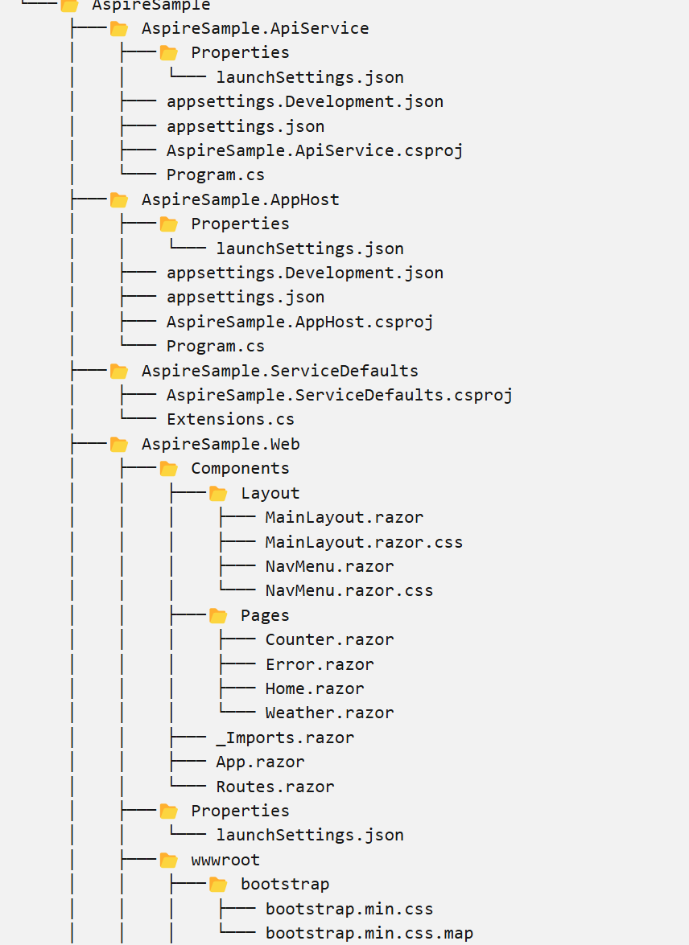
.NET Aspire solution structure
The solution consists of the following projects:
AspireSample.ApiService: An ASP.NET Core Minimal API
AspireSample.AppHost: An orchestrator project AspireSample.ServiceDefaults: A .NET Aspire shared
Notes:
The solution consists of the following projects:
AspireSample.ApiService: An ASP.NET Core Minimal API project is used to provide data to the front end. This project depends on the shared AspireSample.ServiceDefaults project.
AspireSample.AppHost: An orchestrator project designed to connect and configure the different projects and services of your app. The orchestrator should be set as the Startup project, and it depends on the AspireSample.ApiService and AspireSample.Web projects.
AspireSample.ServiceDefaults: A .NET Aspire shared project to manage configurations that are reused across the projects in your solution related to resilience, service discovery, and telemetry.
AspireSample.Web: An ASP.NET Core Blazor App project with default .NET Aspire service configurations, this project depends on the AspireSample.ServiceDefaults project. For more information, see .NET Aspire service defaults.

Slide 18
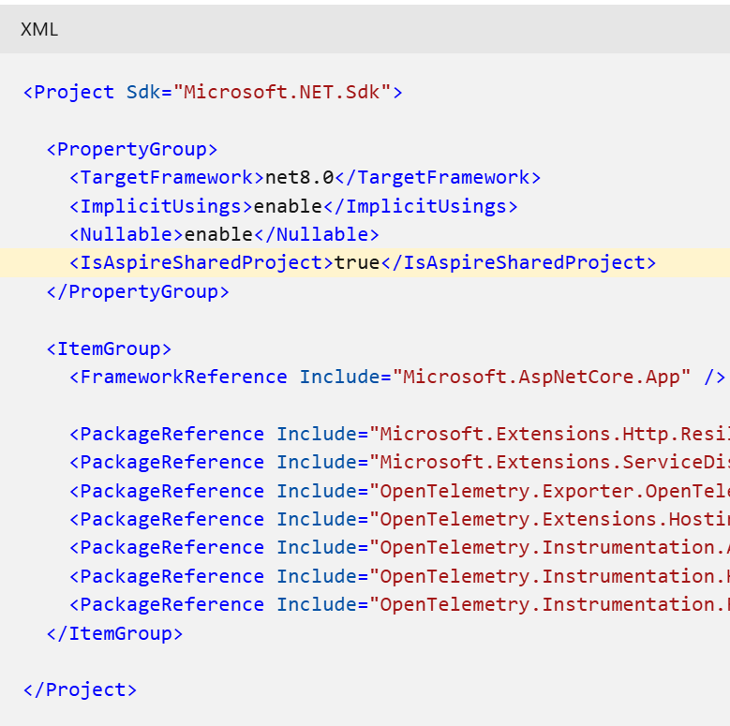
Service default project
Is a shared project that's used to manage configurations that are reused across the projects in your solution.
Share capabilities. This project ensures that all dependent services share the same resilience, service discovery, and OpenTelemetry configuration.
Notes:
The service defaults project exposes an extension method on the IHostApplicationBuilder type, named AddServiceDefaults. The service defaults project from the template is a starting point, and you can customize it to meet your needs.

Slide 19
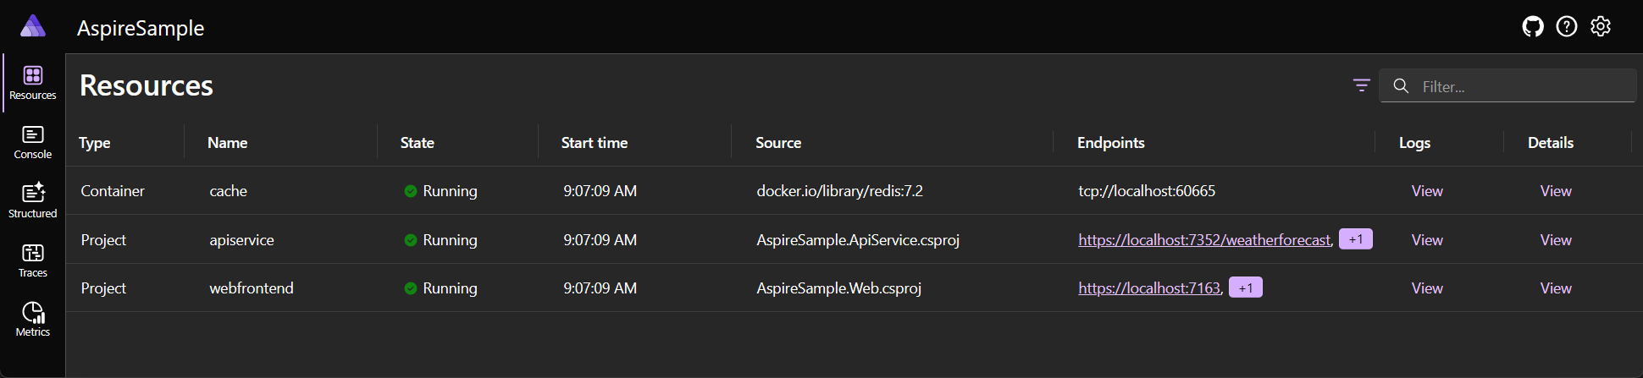
Run my project
Start your project
Trust ASP.NET Core localhost certificate with command,
dotnet dev-certs https –trust
Run project and select the AspireSample.AppHost project with the Default Configuration, dotnet run
Outcome: App displays the .NET Aspire dashboard from where you can reach frontend and API AND telemetry etc..

Slide 20
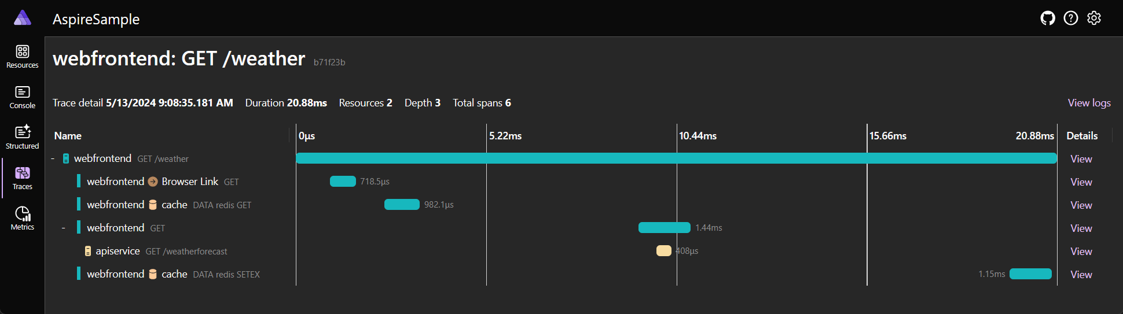
Dashboard in detail
Your best friend
Resources: Lists basic information for all of the individual .NET projects in your .NET Aspire project,
Console: Displays the console output from each of the projects in your app.
Structured: Displays structured logs in table format
Traces: Displays the traces for your application, which can track request paths through your apps
Notes:
Resources: Lists basic information for all of the individual .NET projects in your .NET Aspire project, such as the app state, endpoint addresses, and the environment variables that were loaded in.
Console: Displays the console output from each of the projects in your app.
Structured: Displays structured logs in table format. These logs support basic filtering, free-form search, and log level filtering as well. You should see logs from the apiservice and the webfrontend. You can expand the details of each log entry by selecting the View button on the right end of the row.
Traces: Displays the traces for your application, which can track request paths through your apps. Locate a request for /weather and select View on the right side of the page. The dashboard should display the request in stages as it travels through the different parts of your app.

Slide 21
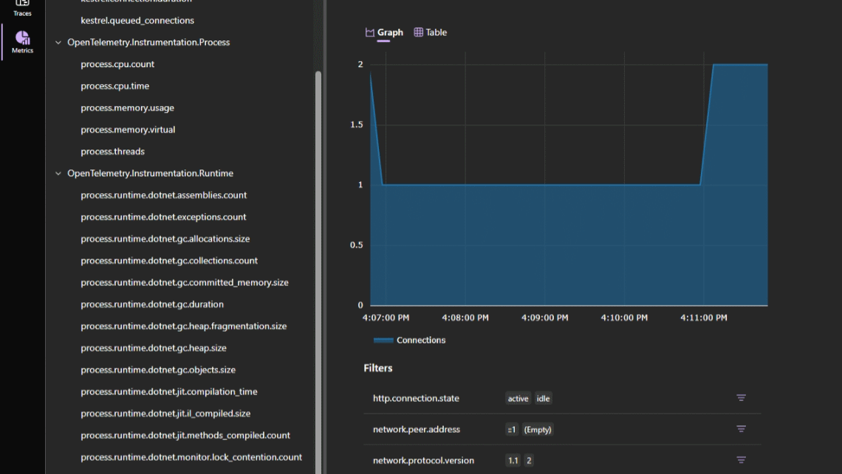
Dashboard in more detail
Looking at metrics
Metrics: Displays various instruments and meters that are exposed and their corresponding dimensions for your app.
Conditionally expose filters based on their available dimensions.

Slide 22

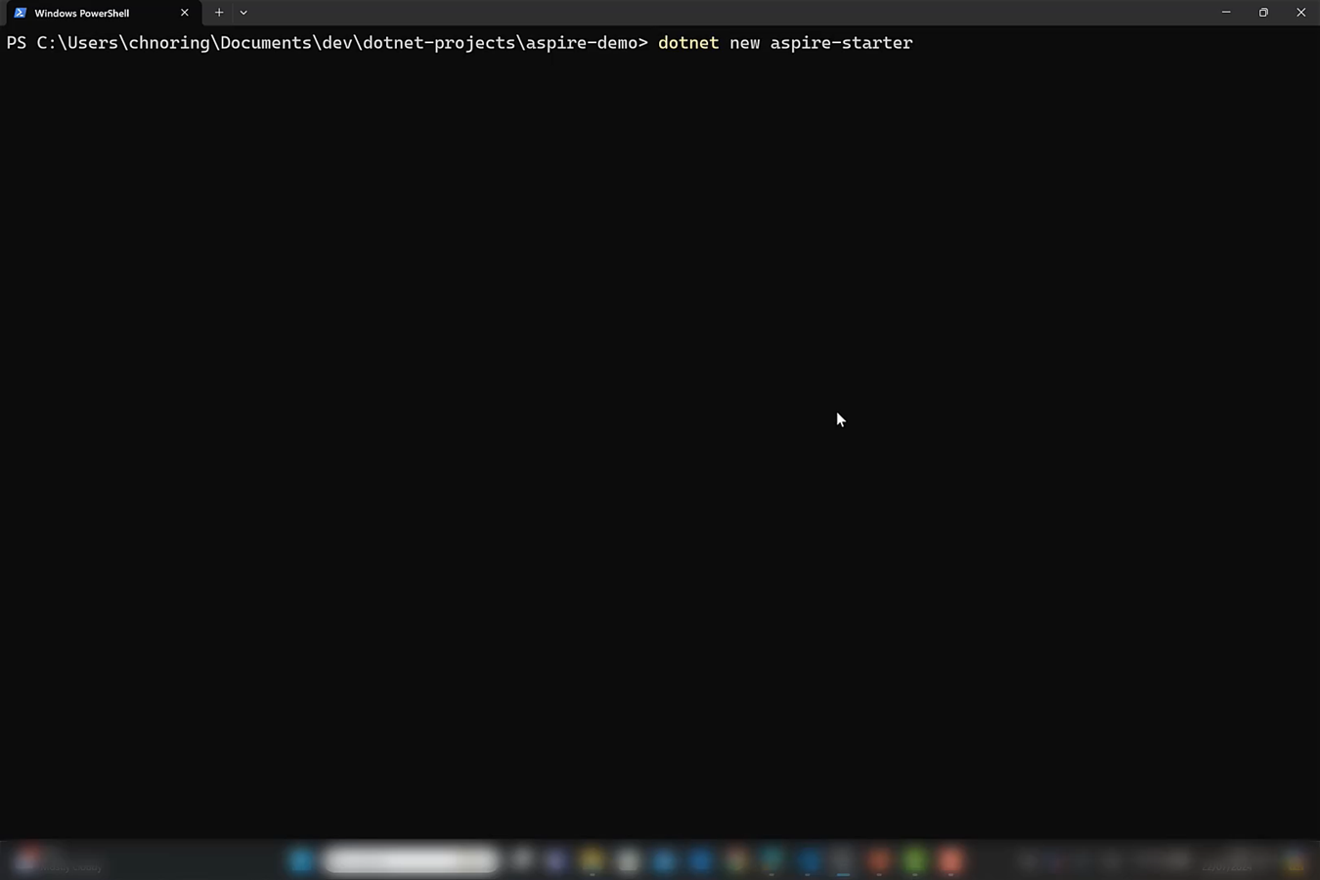
Demo: Scaffold
Scaffold a new
.NET Aspire project

Slide 23
Chapter 3: .NET Aspire orchestration cont..

Slide 24
Orchestration: Manifest file (AppHost)
Program.cs
aspire-manifest.json
"productapi": {
"type": "dockerfile.v0",
"path": "../NodeApi/Dockerfile",
"context": "../NodeApi",
"env": {
"NODE_ENV": "development",
"ConnectionStrings__cache": "{cache.connectionString}",
"PORT": "{productapi.bindings.http.targetPort}"
},
"bindings": {
"http": {
"scheme": "http",
"protocol": "tcp",
"transport": "http",
"targetPort": 8000,
"external": true
}
}
}
var cache = builder.AddRedis("cache");
var productApi = builder.AddNpmApp("productapi", "../NodeApi", "watch")
.WithReference(cache)
.WithHttpEndpoint(env: "PORT")
.WithExternalHttpEndpoints()
.PublishAsDockerFile();
"cache": {
"type": "container.v0",
"connectionString": "{cache.bindings.tcp.host}:{cache.bindings.tcp.port}",
"image": "docker.io/library/redis:7.2",
"bindings": {
"tcp": {
"scheme": "tcp",
"protocol": "tcp",
"transport": "tcp",
"targetPort": 6379
}
}
}
How to create/update
dotnet run
--publisher manifest
--output-path aspire-manifest.json
https://aka.ms/aspire-manifest

Slide 25
Demo: update manifest
Add components, update manifest file

Slide 26
Chapter 4: What about JavaScript + .NET Aspire?

Slide 27
.NET concepts for JavaScript developers
.NET
JavaScript
Project (.csproj)
Solution
NuGet, the system
NuGet package
C# (created by Anders Hejlsberg et al)
Node.js project (package.json)
Monorepo
NPM (Node package manager)
NPM package
TypeScript (created by Anders Hejlsberg et al)

Slide 28
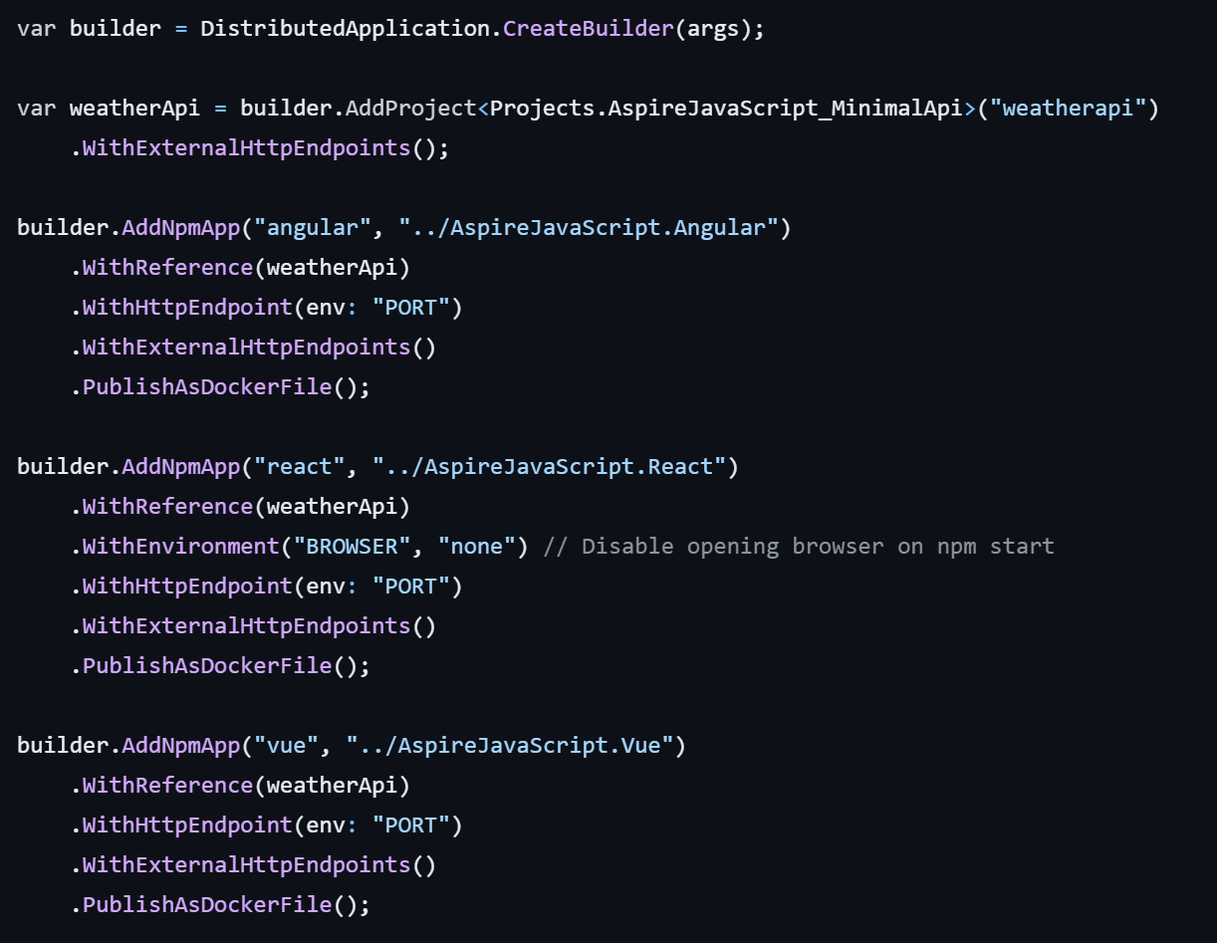
Same idea, AppHost
Orchestrate projects in AppHost
WithReference, connect backend with frontend
Compose. Add whatever components you want here, e.g Redis, ServiceBus etc
https://aka.ms/aspire-javascript
Notes:
First selection, .NET aPI
Second selection, let frontend know about backend, now they can talk to each other

Slide 29
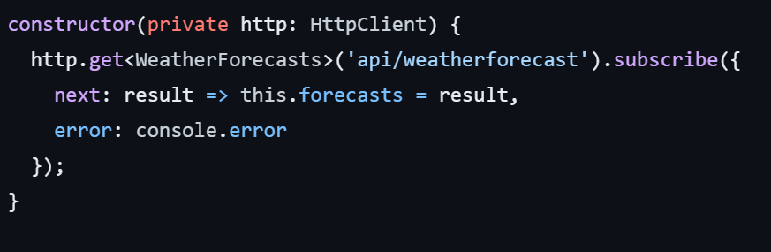
Just works, Frontend project
API backend is available in proxy.conf.js (env variables)
module.exports = {
"/api": {
target:
process.env["services__weatherapi__https__0"] ||
process.env["services__weatherapi__http__0"],
secure: process.env["NODE_ENV"] !== "development",
pathRewrite: {
"^/api": "",
},
},
};

Slide 30
Chapter 4.1 What about Node.js + .NET Aspire?

Slide 31
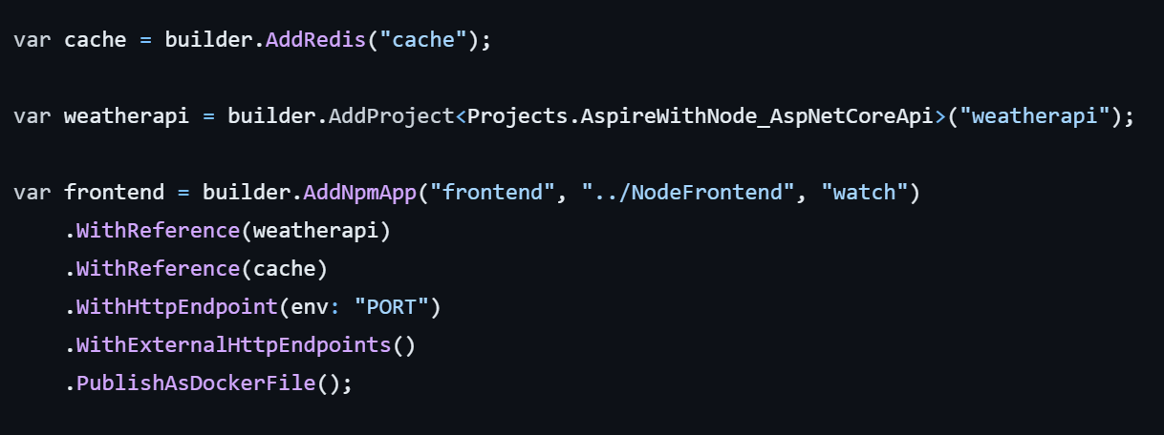
Same idea, AppHost
Orchestrate projects in AppHost
WithReference, connect backend with frontend
Compose. Add whatever components you want here, e.g Redis, ServiceBus etc
https://aka.ms/aspire-javascript
Notes:
First selection, .NET aPI
Second selection, let frontend know about backend, now they can talk to each other

Slide 32
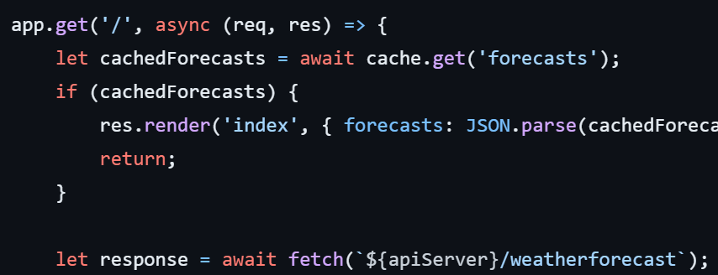
In the Node.js app
Retrieves addresses from .NET Aspire project
Retrieving cache address AND api URL based on name of resources e.g cache and weatherapi + prefixes ConnectionStrings_ and services__
Gets data from caches or calls API

Slide 33
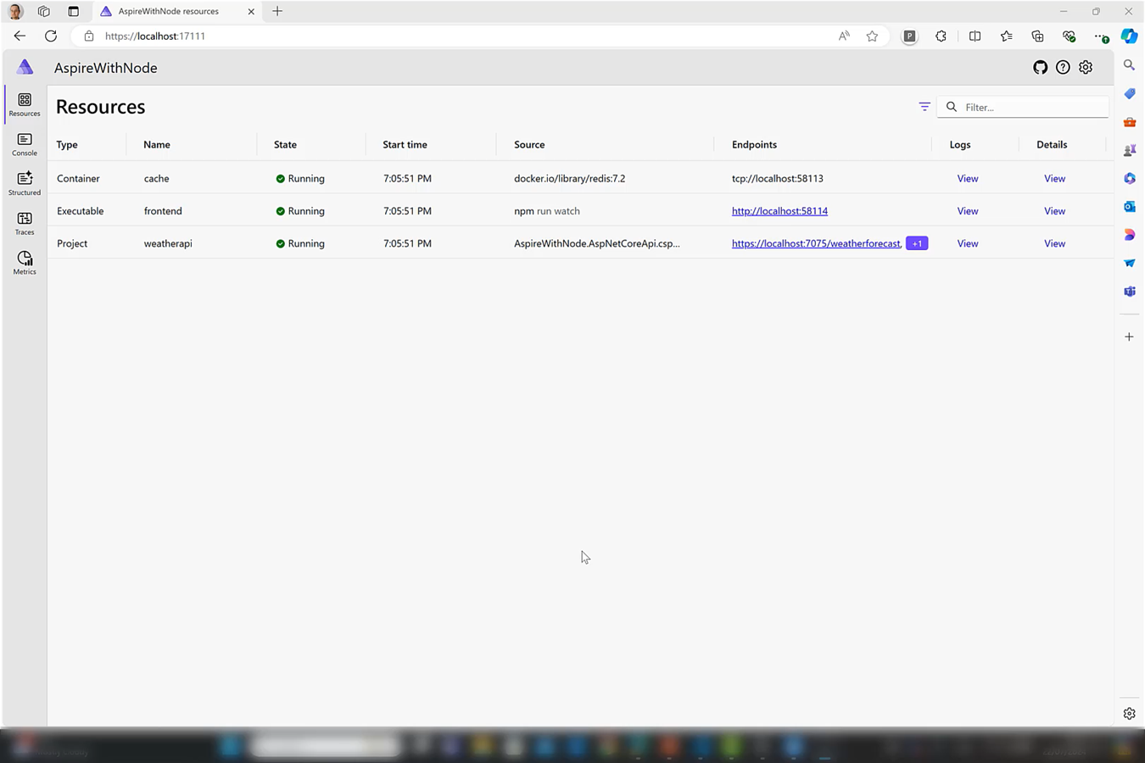
Demo: a JavaScript project
Run a JavaScript project

Slide 34
For JavaScript in .NET Aspire
Dockerize your app e.g Dockerfile
AppHost:
Add project, AddNpmApp()
Add dependencies, WithReference(),
Generate manifest file to know env variables you can use

Slide 35
Summary
.NET Aspire, solves common problems for Cloud apps
Core concepts, three core projects, named references, config managed
Bring your runtime, .NET Aspire helps orchestrate and mix and match

Slide 36
.NET Aspire Developers Day
Start your learning journey:
aka.ms/dotnetAspireDevDay/Collection

